Slide 1
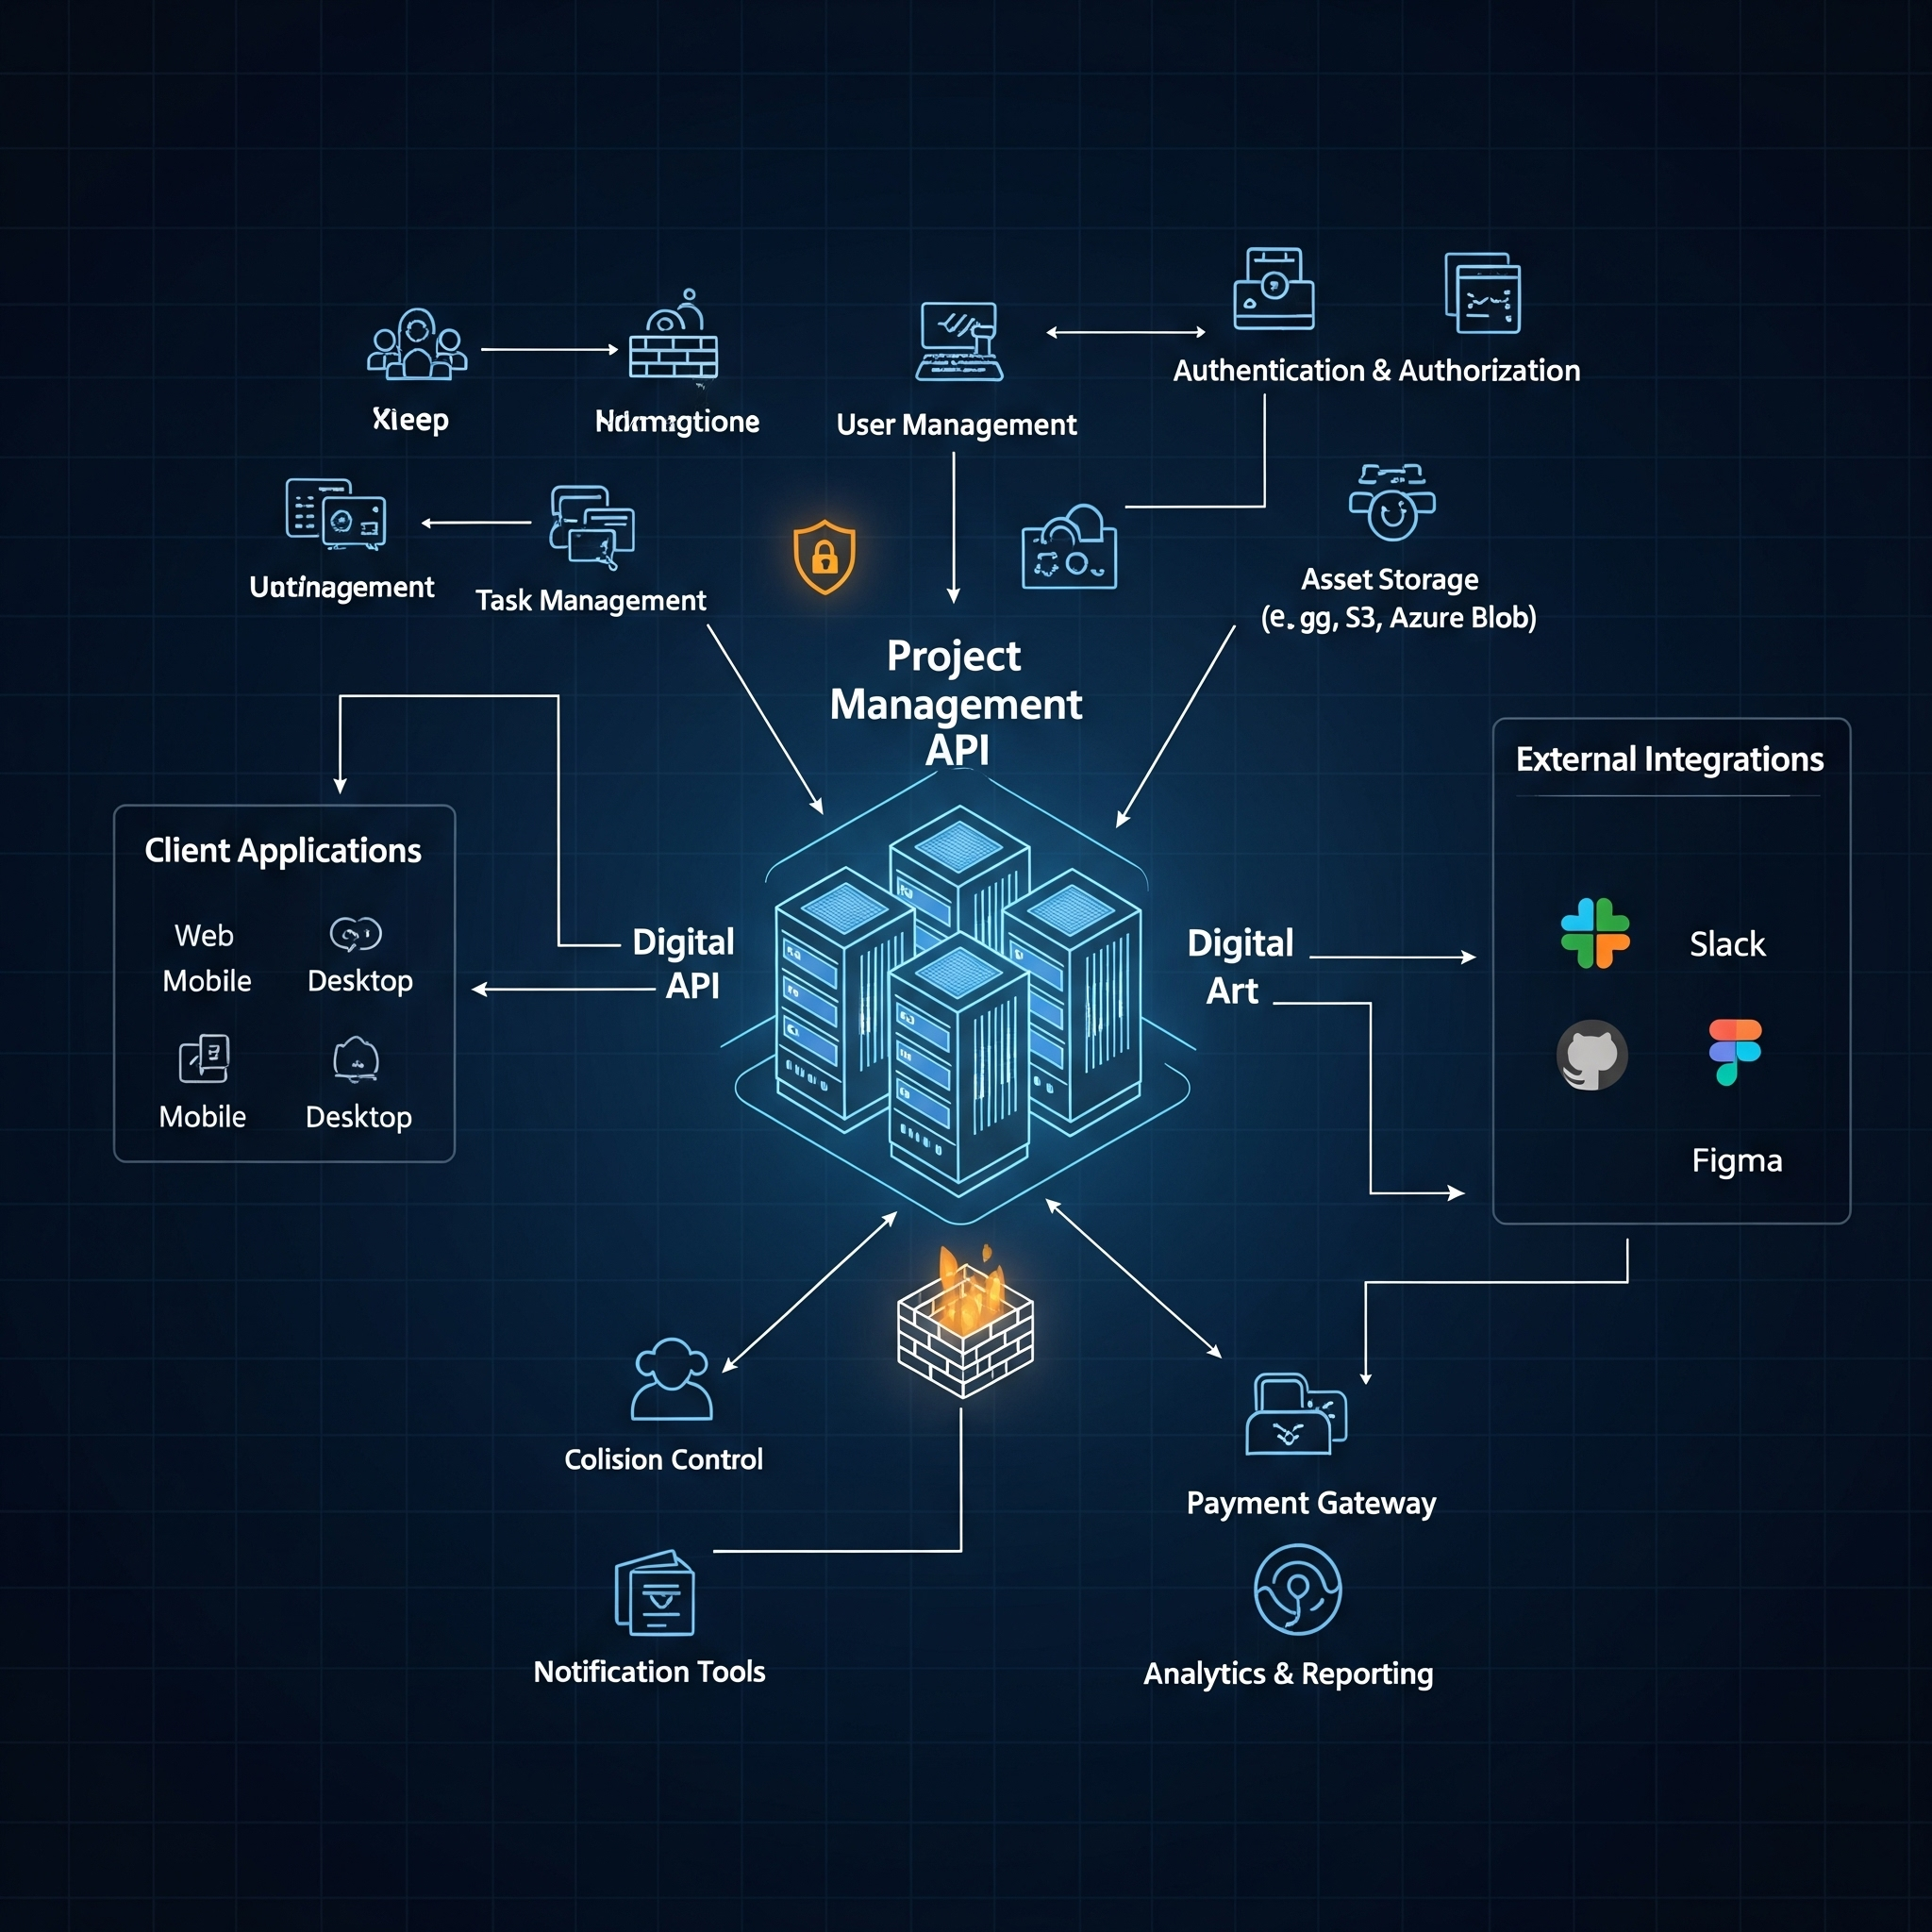
Project Management System
The Project Management System offers security
Scalable modern REST API architecture solution
Built with professional Enterprise-Grade Architecture
Notes:
Good morning. I’m presenting the Project Management System, a custom-built solution designed to handle your data securely and efficiently.
Built on Spring Boot 3 and Java 21.

Slide 2
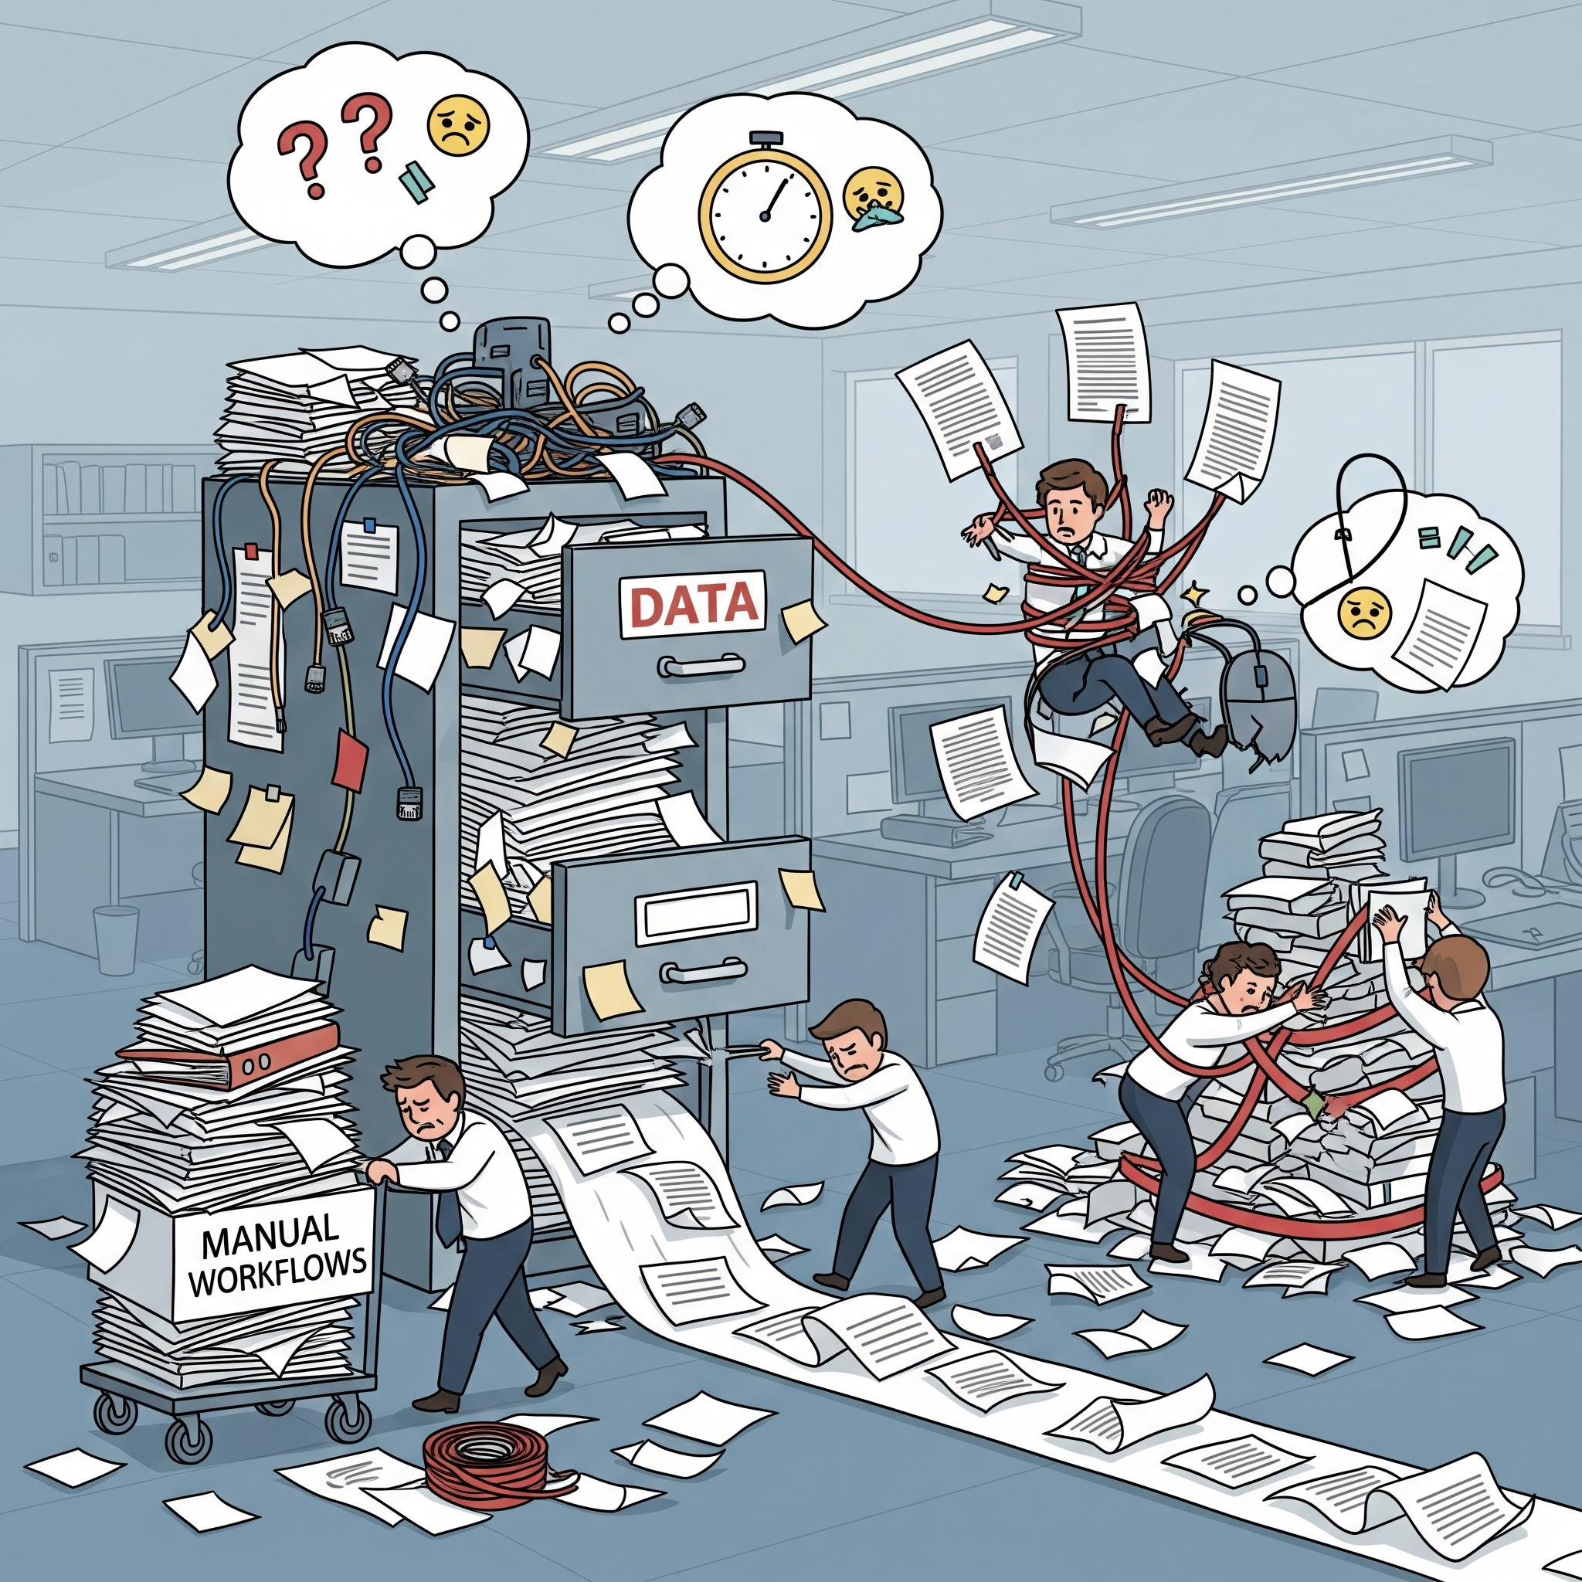
The Business Challenge
Disorganized data tracking within shared spreadsheets
Lack of clear data ownership and proper security
Inefficient manual workflows slow down operations
High risk of potential data loss and reduced productivity
Notes:
We identified that managing tasks in spreadsheets leads to data loss and lack of ownership tracking. You need a system that enforces rules.
The goal was to move from unstructured data to a relational model with strict ACID compliance.
ACID stands for Atomicity, Consistency, Isolation, and Durability.
Here is what each term means, using examples from your Project Management System:
1. Atomicity ("All or Nothing")
This property treats a transaction as a single, indivisible unit. Either all steps in the transaction succeed, or none of them do. If one step fails, the entire transaction is rolled back to the state it was in before the transaction started.
Real-world Analogy: Buying a coffee. You tap your card. Two things must happen: money leaves your account, and the cafe gets the money. If the machine crashes after money leaves your account but before the cafe gets it, the bank reverses (rolls back) the charge. You don't lose money.
In Your Project: Imagine you have a method that deletes a Project.
Delete all Tasks associated with the Project.
Delete the Project itself.
If the database deletes the tasks but fails to delete the project (maybe a constraint violation), Atomicity ensures the tasks are "undeleted" (rolled back). You are never left with a "Zombie Project" that has no tasks but shouldn't exist.
2. Consistency ("Valid Data Only")
This ensures that a transaction brings the database from one valid state to another valid state, maintaining all database rules (constraints, cascades, triggers, foreign keys).
In Your Project:
You have a foreign key constraint: A Task must belong to a Project.
If you try to insert a Task with project_id = 999, but Project 999 doesn't exist, the database rejects the transaction.
Consistency guarantees that your database never contains "orphaned" tasks pointing to non-existent projects.
3. Isolation ("My Business is My Business")
This property ensures that transactions happen independently and securely without interference from other concurrent transactions. If two users try to change the same data at the same time, they shouldn't see each other's half-finished work.
Real-world Analogy: Two people editing a shared Google Doc vs. a standard Word doc. In a database, we usually want the "standard Word doc" behavior—I can't see your typing until you hit "Save."
In Your Project:
User A requests GET /projects/1.
User B sends DELETE /projects/1 at the exact same millisecond.
Isolation levels determine what happens. Ideally, User A either sees the project before the delete, or gets a 404 after the delete. They should never see a project that is half-deleted (e.g., the project exists but the tasks are gone).
4. Durability ("Saved means Saved")
This guarantees that once a transaction has been committed (saved), it will remain saved even in the event of a power loss, crash, or system error.
In Your Project:
You create a new User and get a 201 Created response.
One second later, the server running PostgreSQL crashes.
When the server restarts, that User must still be there. PostgreSQL achieves this by writing to a transaction log (Write-Ahead Logging or WAL) on the hard drive before confirming the save.

Slide 3

The Solution: Management
Spring Boot REST API ensures secure access
Provides real-time data availability for users
Scalable architecture supports future growth
Centralizes data for a single source of truth
Notes:
We built a centralized REST API. It acts as a single source of truth, allowing your front-end applications to Create, Read, Update, and Delete data reliably.
It adheres to RESTful maturity level 2, using proper HTTP verbs (GET, POST, PUT, DELETE) and status codes.
The Richardson Maturity Model (RMM) is a way to grade how "RESTful" an API is. It breaks down the journey into four levels (0 to 3).
Level 2 is generally considered the standard for a "true" REST API. It is where you start using HTTP verbs (GET, POST, PUT, DELETE) correctly to manipulate resources.
Here is a breakdown of the levels to help you understand where Level 2 fits in.
The Levels at a Glance
Level 0: One URL, One Method (The "Swamp of POX").
Level 1: Many URLs (Resources).
Level 2: Many URLs + HTTP Verbs (Standard Methods).
Level 3: Hypermedia (HATEOAS) - The API tells you what to do next.
Level 2 Explained: "Using HTTP Verbs Correctly"
At Level 2, you stop treating HTTP as just a transport tunnel (like sending everything via POST) and start using the HTTP Standard as it was intended.
1. The Core Concept
In Level 2, the verb defines the action.
If you want to get data, you must use GET.
If you want to create data, you use POST.
If you want to delete data, you use DELETE.
You also start using HTTP Status Codes correctly.
Success isn't just 200 OK. It might be 201 Created or 202 Accepted.
Failure isn't just a generic error inside a JSON body. It's 404 Not Found or 403 Forbidden.
2. Comparison: Level 1 vs. Level 2
Imagine an API for ordering pizza.
Level 1 (Resources only): You have unique URLs for each pizza order, but you use POST for everything.
Request: POST /orders/123/delete
Request: POST /orders/123/update
Response: 200 OK (with a body saying "Deleted successfully")
Level 2 (Resources + Verbs): You use the same URL, but change the verb.
To View: GET /orders/123
To Delete: DELETE /orders/123
To Update: PUT /orders/123
Response (Delete): 204 No Content (The standard code for "Deleted, nothing to show").
Why is Level 2 Important?
Standardization: Any developer knows that DELETE means delete. They don't have to read your documentation to find out if the endpoint is named /deleteUser or /remove-user.
Safety & Idempotency:
GET is "safe" (it doesn't change data). Browsers and caches know they can cache GET requests freely.
PUT and DELETE are "idempotent" (doing it 5 times is the same as doing it once). If the network fails, it's safe to retry.
Tooling Support: Postman, browsers, and proxies handle standard HTTP verbs and status codes automatically (e.g., a proxy won't cache a POST request, but it will cache a GET).
In Your Project
Your Spring Boot application is likely Level 2 because:
You use @GetMapping, @PostMapping, @DeleteMapping.
You return HttpStatus.CREATED (201) when making a User.
You return HttpStatus.NOT_FOUND (404) when a project isn't found.
Level 3 (The Next Step): Would involve adding links to your JSON response (HATEOAS) telling the client what they can do next (e.g., _links: { "delete": "/projects/1" }). Most modern APIs stop at Level 2 because Level 3 is complex to implement.

Slide 4
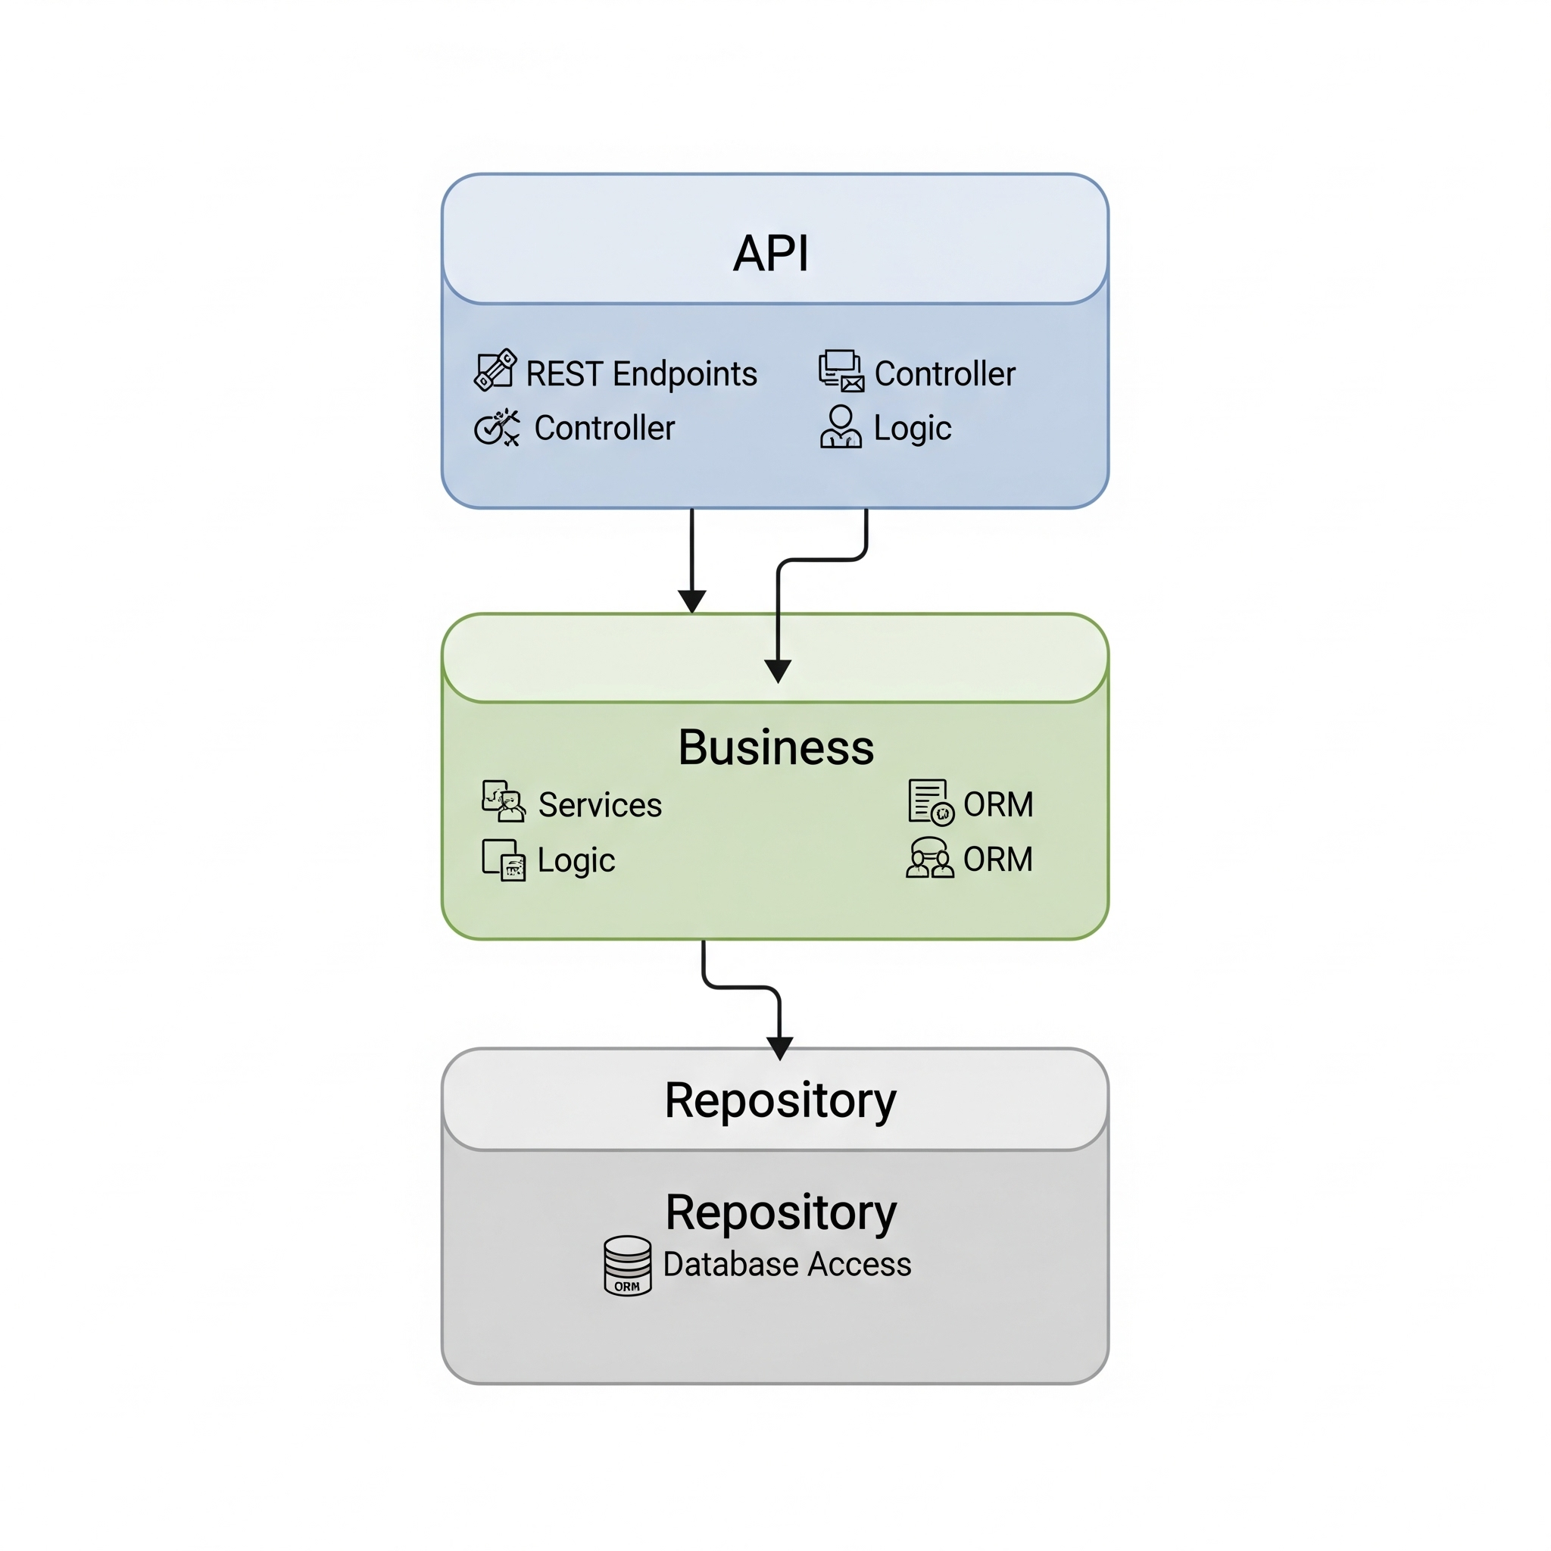
System Architecture Layers
Multi-Module Maven Design separates concerns effectively
API Contract is distinct from the Business Logic layer
Controller Layer handles the exposed API endpoints
Service Layer manages the core business logic functions
Repository Layer interacts with the PostgreSQL database
Notes:
We designed the system using a modular approach. This means if we need to upgrade the database logic later, it won't break the external interface.
"I used a Multi-Module Maven project structure. I separated the spring-starter-api (generated interfaces) from the spring-starter-service (logic) to enforce a strict separation of concerns.

Slide 5
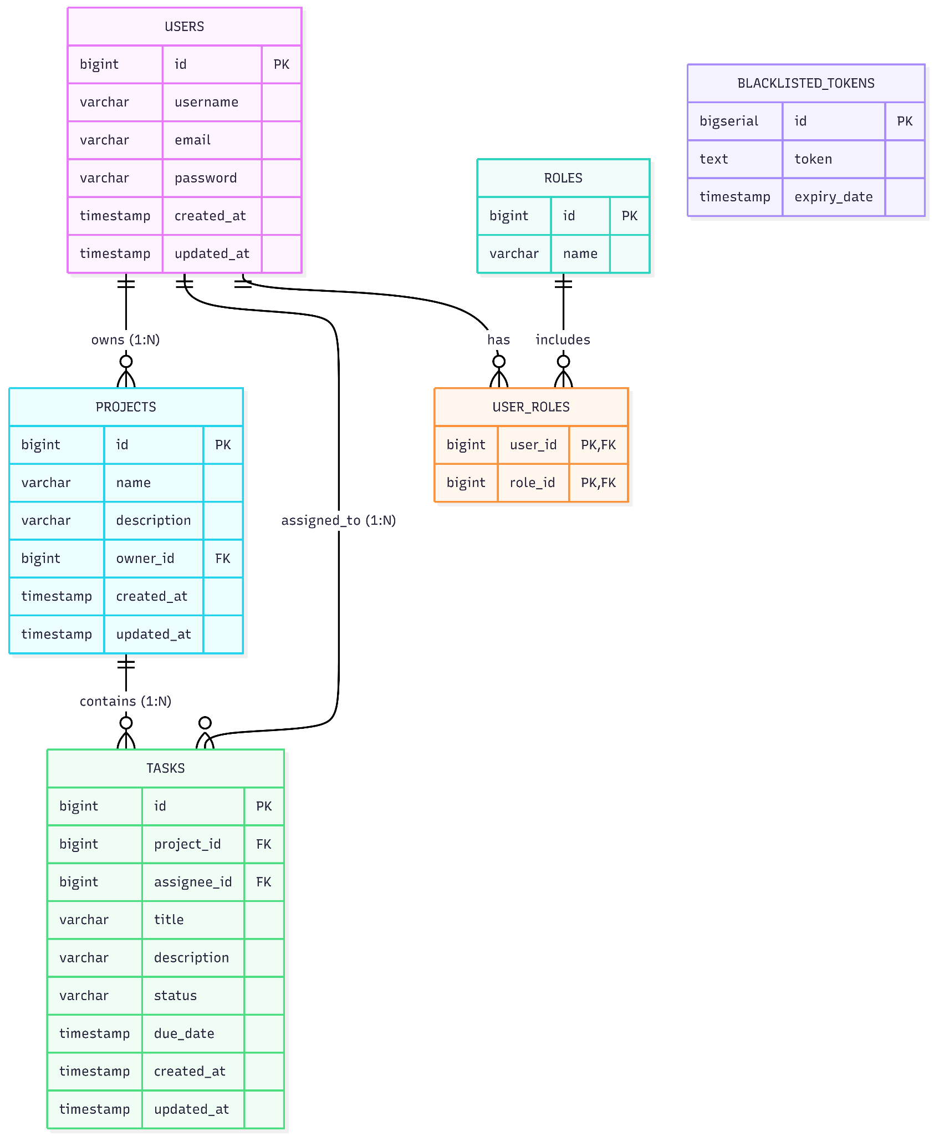
Data Domain Model
User is the root entity with secure credentials
Project entities are owned by users (1-to-Many)
Task belongs to a Project entity (1-to-Many)
Database constraints ensure strict data integrity is maintained
Notes:
Here is how your data is organized. A User owns Projects, and Projects contain Tasks. We enforce strict ownership rules—a task cannot exist without a project.
I implemented JPA relationships (@OneToMany, @ManyToOne) with FetchType.LAZY for performance. I also used AuditingEntityListener to automatically track @CreatedDate and @LastModifiedDate.

Slide 6
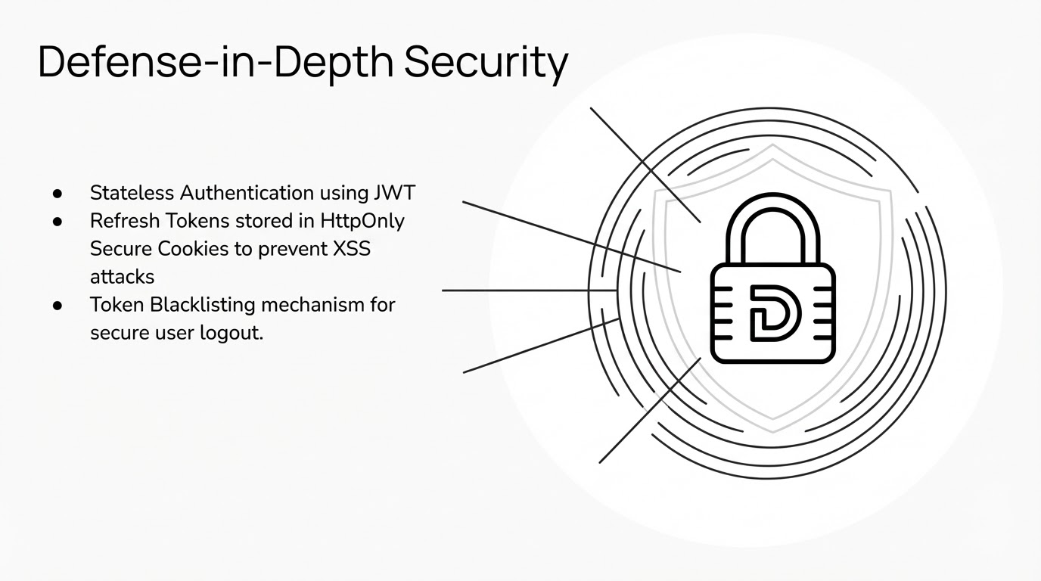
Notes:
Security is our top priority. We use a 'Defense in Depth' strategy. We don't just check if you are logged in; we ensure your session tokens cannot be stolen by malicious scripts.
I implemented a stateless JWT architecture with a dual-token system (Access + Refresh). The Refresh Token is stored in an HttpOnly, Secure Cookie to prevent XSS attacks. I also built a Token Blacklist service backed by the DB to handle logouts securely.

Slide 7
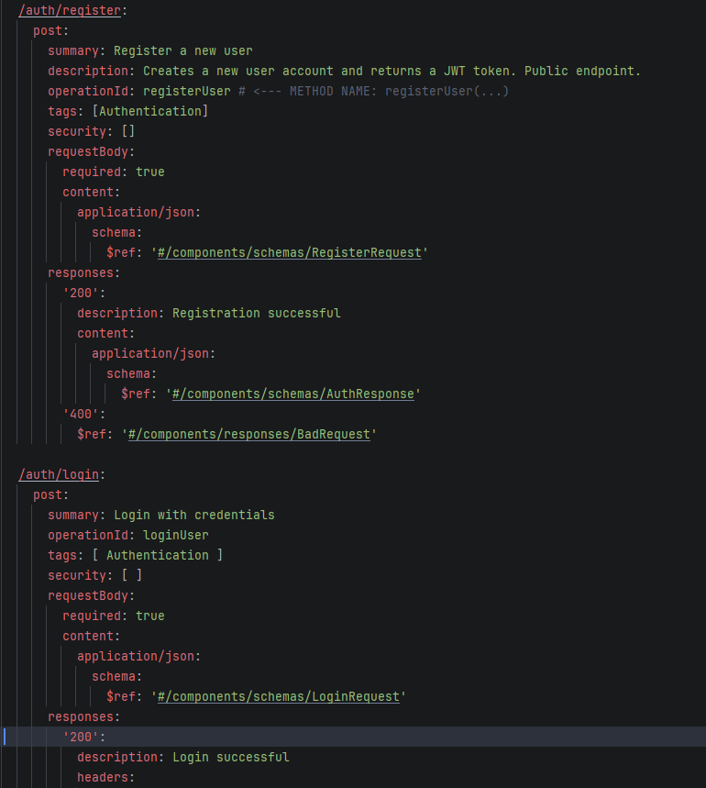
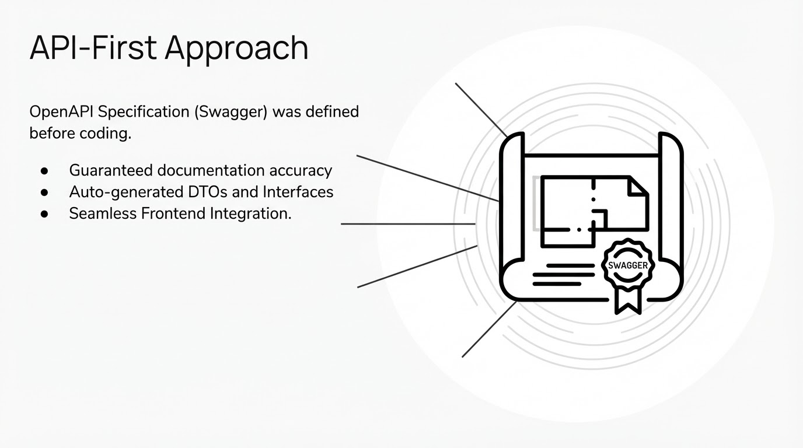
Notes:
We defined the 'Contract' before writing the code. This ensures that the documentation you see is exactly what the system does—no surprises.
I used the openapi-generator-maven-plugin to generate my Interfaces and DTOs directly from the YAML spec. This prevents drift between documentation and implementation.

Slide 8
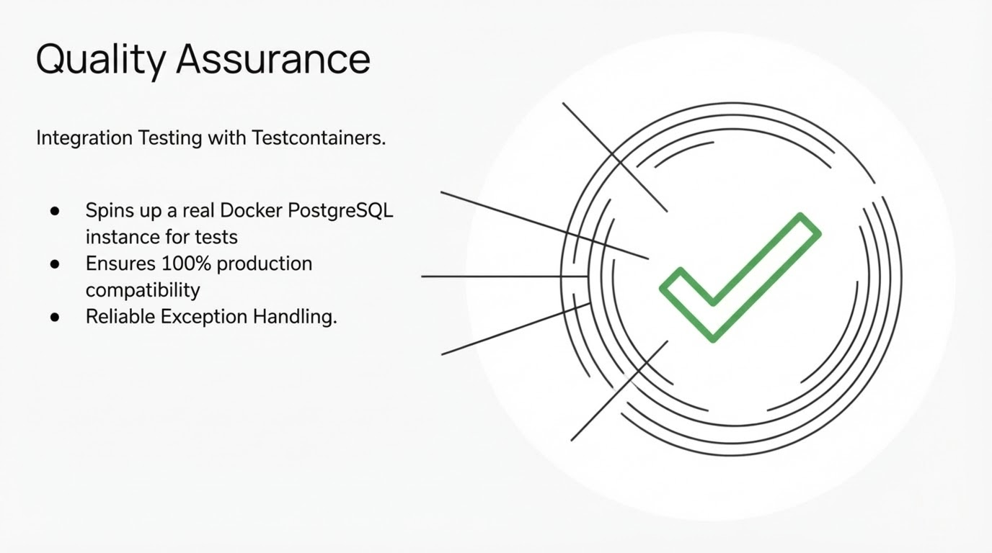
Notes:
We didn't just hope it works; we tested it against a real database environment to ensure reliability.
I utilized Testcontainers to spin up a transient PostgreSQL Docker container for integration tests. This avoids the common pitfalls of testing against H2 (in-memory) which behaves differently than production Postgres.

Slide 9
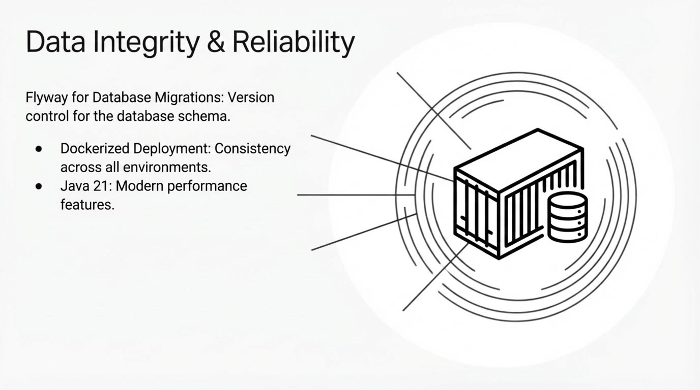
Notes:
The system is packaged in a standard container, making it easy to deploy to the cloud. We also version-control the database structure.
I used Flyway for database migrations to ensure schema consistency. The application is containerized using a multi-stage Dockerfile (Build vs Run stages) to keep the image size small and secure.

Slide 10
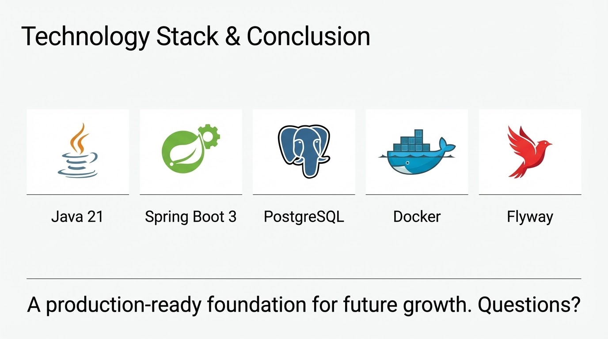
Notes:
In summary, you have a secure, documented, and scalable foundation ready for your frontend team.
I'm happy to answer questions about the MapStruct implementation, the GlobalExceptionHandler, or the Security Filter Chain configuration.

